Slide 1
Data Link Layer Part II: Framing and Error Handling

Slide 2
Overall Picture: Data Link Layer and Medium Access Control
Data Link Layer: Creating a reliable link requires:
This transmission should be reliable ➔ Data Link Control
Network nodes should be able to transmit over the physical channel as if nodes are connected by a direct link ➔ Medium Access Control (Later)
(think of wireless links, there is no direct link!!!!)

Slide 3
Data Link Layer Tasks
Physical:
Framing, Error handling
Depends on encoding in the physical layer
MAC: Channel Access
DLC: Flow and congestion control, reliable delivery (We know all the tactics from reliable transport chapter)

Slide 4

Physical Layer: Encoding
Digital signal
Discrete, discontinuous voltage pulses
Each pulse is a signal element
Binary data encoded into signal elements
Waveform is constructed
Example: NRZ (non-return to zero)
Discrete, discontinuous voltage pulses
Can lose synchronization with long strings of 1’s and zeroes

Slide 5
Interpreting Signals
Need to know
Timing of bits - when they start and end➔ requires that sender and receiver are synchronized
Signal levels
Factors affecting successful interpreting of signals
Signal to noise ratio
Data rate
Bandwidth

Slide 6
Framing
DLL breaks bit stream into discrete frames
Computes checksum of each frame (control information)
Start + end of frame determination

Slide 7
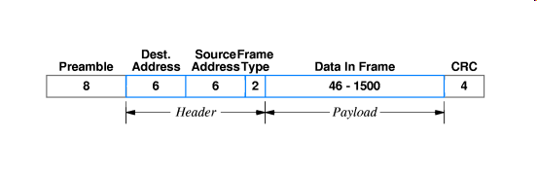
Framing with delimiting
Example: Ethernet has the preamble field:
64-bit (8 byte) field
contains a synchronization pattern consisting of alternating ones and zeros and ending with two consecutive ones.
Synchronization is between sender’s bit times and the receivers’ bit times such that the receivers can read the bits correctly from the signal on the physical medium
After synchronization is established, the preamble is used to locate the first bit of the packet. The preamble is generated by the LAN interface card.
Example: Ethernet Frame
Bit pattern to show
beginning of the frame and to synchronize sender and receiver
Error checking pattern

Slide 8
Bit patterns for frame delimiting
Each frame begins and ends with a special bit pattern called a flag byte for example: [01111110].
Example:
[01111110][01011011111100011111] [01111110]
flag Message flag
PROBLEM: flag byte can appear in the message

Slide 9
Bit Stuffing
Sender prevents certain bit patterns in the outgoing bit stream
Example patterns:
Special start of frame, end of frame flag bytes
Long strings of 1s or 0s in NRZ coded signals
Sender automatically stuffs bits in the outgoing stream
Increases the number of bits that are sent
Receiver destuffs according to the rule

Slide 10

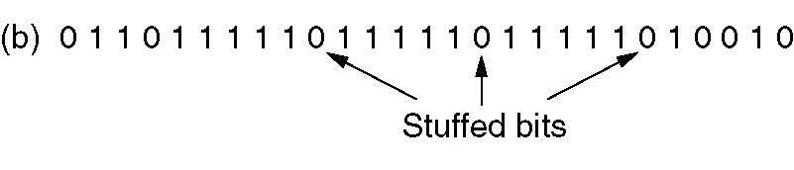
Example: Bit stuffing
Prevent: 01111110 in the data
Sender: stuffs a 0 in the outgoing stream whenever it encounters five consecutive ones in the data stream
Receiver: destuffs the 0 bit when it sees five consecutive incoming ones followed by a 0 bit, before sending the data to the upper layer.
Original
After stuff
After destuff

Slide 11
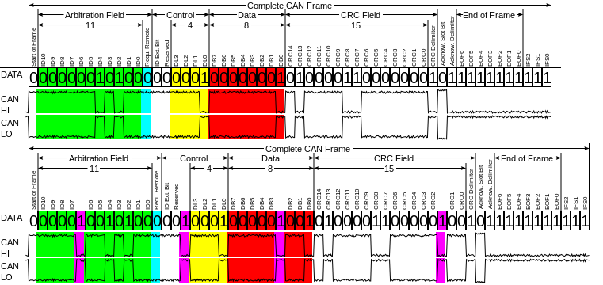
Example: CAN Bus bit stuffing
Controller Area Network (CAN):
Bus standard that defines data link layer in Automotive networks
NRZ encoding
To ensure enough transitions to maintain synchronization, a bit of opposite polarity is inserted after five consecutive bits of the same polarity. The stuffed data frames are destuffed by the receiver.
CAN-Frame before and after the addition of stuffbits
(in purple)

Slide 12
Error Control
Applications require certain reliability level
Data applications require error-free transfer
Voice & video applications tolerate some errors
Transmission errors exist
Single bit errors
Burst errors
Lost frames vs. Damaged frames

Slide 13
Detecting Errors
Frame with checksum
Frame
Channel
Checksum checker
User
Information
Checksum
Calculator
Deliver user
information or
set error alarm
For a block of k bits of user information checksum calculator generates r bits
Frame with checksum: k+r bits has a property known by the checksum checker
It is an error if the property s not satisfied

Slide 14
Polynomial Codes
Associate bits with coefficients of a polynomial
Message: 1 0 1 1 0 1 1➔
M(x): 1x⁶+0x⁵+1x⁴+1x³+0x²+1x+1 = x⁶+x⁴+x³+x+1
Also called cyclic redundancy check (CRC) codes
Most data communications standards use polynomial codes for error detection

Slide 15
Polynomial Codes
Compute r bits such that:
k+r bits frame is a sequence which is exactly divisible by some number
Remember there are many bit patterns of k+r bits that are not exactly divisible by the designated number
Receiver divides frame by that number
If no remainder ➔received a codeword ➔assume no error

Slide 16
Cyclic Redundancy Check
Let M(x) be the message polynomial
Let P(x) be the generator polynomial
Generates the redundant bits
P(x) is fixed for a given CRC scheme
r+1 bits long
P(x) is known both by sender and receiver

Slide 17
Cyclic Redundancy Check
Create and send a block polynomial F(x) based on M(x) and P(x) such that F(x) is divisible by P(x)
All operations are in binary modular arithmetic not the standard binary arithmetic
Binary modular addition is equivalent to binary modular subtraction

Slide 18
Cyclic Redundancy Check
Create and send a block polynomial F(x) based on M(x) and P(x) such that F(x) is divisible by P(x)
Creating F(x)
Multiply M(x) by x^{r}
Divide x^{r}M(x) by P(x) → x^{r}M(x) = P(x).Q(x)+C(x)
Ignore Q(x) and keep the reminder C(x)
Form and send F(x) = x^{r}M(x)+C(x) that is divisible by P(x)
Receiver gets F’(x) (there might be some changed bits by error)
Checks F’(x) / P(x) The remainder is zero➔ No error

Slide 19
Proof of CRC Generation
Binary modular addition is equivalent to binary modular subtraction

Slide 20
Example
Send
M(x) = 110011 → x⁵+x⁴+x+1 (6 bits)
P(x) = 11001 → x⁴+x³+1 (5 bits, r = 4) → 4 bits of redundancy
Form x^{r}M(x) → 110011 0000 → x⁹+x⁸+x⁵+x⁴
Divide x^{r}M(x) by P(x) to find C(x)
Receive
No remainder
→ Accept
ALL OPERATIONS ARE
BINARY MODULO 2
= C(x)
Send the block 110011 1001

Slide 21
CRC
Which errors can be detected?
can detect all burst errors less than r+1 bits
Why?
Which errors cannot be detected?

Slide 22
Standard Generator Polynomials
CRC = cyclic redundancy check
CRC-8:
CRC-16:
CCITT-16:
CCITT-32:
= x⁸ + x² + x + 1
ATM
= x¹⁶ + x¹⁵ + x² + 1
= (x + 1)(x¹⁵ + x + 1)
Bisync
= x¹⁶ + x¹² + x⁵ + 1
HDLC, XMODEM, V.41
IEEE 802, DoD, V.42
= x³² + x²⁶ + x²³ + x²² + x¹⁶ + x¹² + x¹¹ + x¹⁰ + x⁸ + x⁷ + x⁵ + x⁴ + x² + x + 1

Slide 23
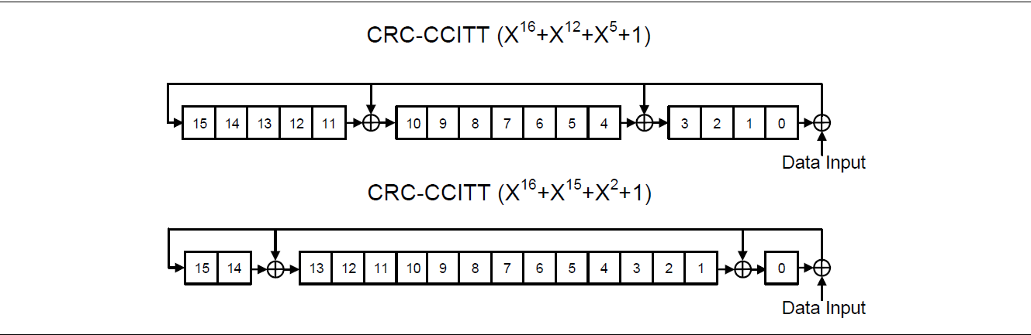
CRC implementation
Implemented using shift-register circuits

Slide 24
Error Control
Automatic Repeat Request: ARQ
Error-detecting codes: CRC, checksum etc.
When error is detected the block or the frame containing the block has to be retransmitted
Stop and Wait, Go Back N, Selective Repeat
Forward Error correction
The frames carry enough information to correct the error
Error-correcting codes: Hamming codes…
Hybrid: ARQ and FEC may be combined, such that minor errors are corrected without retransmission, and major errors are corrected via a request for retransmission

Slide 25
Remember: Performance of Stop and Wait with error
timeout
timeout
H
H
D
D
D
D
H
H
A
k: number of unsuccessful attempts
For the Data link Layer: Sender and receiver are connected by a single link

Slide 26
Remember: Performance of Stop and Wait with error
Expected number of transmissions :
Expected number of retransmissions:
Efficiency:

Slide 27
Finding the probability of Success
P₁: P{loss/error of data packet}
P₂: P{loss/error of ACK}
P_{success}=(1-P₁)(1-P₂)

Slide 28
Error Rate
Error rate
Bit error rate (BER) : probability of a transmitted bit being received wrong
e.g., 10⁻⁷ for satellite, 10⁻⁹ for MW, 10⁻¹¹ for fiber
Packet/frame error rate
For a given BER and frame length n
P[frame correct]= (1-BER)^{n}
P[frame has error]=1- (1-BER)^{n} ≅ n x BER (for large n and small BER)

Slide 29
Finding the probability of Success
P₁=(D+H)E_{sr}
E_{sr}: Error rate on the channel from sender to receiver
P₂=AE_{rs}
E_{rs}: Error rate on the channel from receiver to sender
P_{success}=(1-P₁)(1-P₂) =1-L

Slide 30
Where to use which approach?
Applications on error prone channels with high bit error
Should use ARQ. FEC requires a lot of redundancy
Applications that require low latency such as telephone conversations, channels with very large round-trip delay
cannot use ARQ: By the time an ARQ system discovers an error and re-transmits it, the re-sent data will arrive too late to be any good.

Slide 31
Where to use which approach?
Applications where the transmitter immediately forgets the information as soon as it is sent. The transmitter does not have enough buffer space for storing the frame(s) for retransmission
cannot use ARQ: when an error occurs, the original data is no longer available.
Applications that have no return channel
cannot use ARQ.
Applications that require extremely low error rates
must use ARQ. Using FEC will be waste of bits

Slide 32
Data Link Layer Part II: Framing and Error Handling

